Slide 1
RAINFALL PREDICTION USING ARIMA AND LINEAR REGRESSION
DOMAIN : Machine Learning
BATCH : A12
NAME : Supriya. S (211418104275)
Surya. P (211418104278)
Swetha. N (211418104284)
GUIDE NAME:- Dr.K.Sangeetha, M.E., Ph.D.

Slide 2
ABSTRACT
Rainfall forecasting is very important because heavy and irregular rainfall can have many impacts like the destruction of crops and farms, and damage of property so a better forecasting model is essential for an early warning that can minimize risks to life and property and also manage the agricultural farms in a better way.
The proposed methodology predicts annual rainfall by time series ARIMA model and Linear Regression a machine learning algorithm.
Time series data have been used extensively in classical statistics. The ARIMA has been trained to produce excellent outcomes.
The ARIMA model demonstrated greater accuracy in all seasonal and yearly rains. To offer a solid prediction, this method, like time series ARIMA, requires a strict assumption of stationarity.
We use the real data from the Kaggle and compare the model quality based on several criteria in ARIMA.

Slide 3
LITERATURE SURVEY
LITERATURE SURVEY
AUTHORS | TITLE | METHODOLOGY | MAJOR FINDINGS
Nana Kofi Ahoi Appiah-Badu(2021) | Rainfall Prediction Using Machine Learning Algorithms for the Various Ecological Zones of Ghana. | DT(Decision Tree), RF, Multilayer Perceptron (MLP), XGB (Extreme Gradient Boosting) and K-NN | In this paper, Decision Tree is consistently portrayed as the fastest, whereas MLP used the most run time.
Dechao Sun (2021) | Prediction of Short-Time Rainfall Based on Deep Learning. | GRU | The experimental results reduce the error between the predicted value and the real value of rainfall and improve the accuracy of short-term rainfall prediction.
Wanie M. Ridwan (2020) | Rainfall forecasting model using machine learning methods | BLR(Bayesian Linear Regression), Boosted Decision Tree Regression, DFR(Decision Forest Regression) and Neural Network Regression. | Forecasting Rainfall Using Autocorrelation Function shows high accuracy.
Uchamad Taufiq Anwar(2020) | Rain Prediction Using Rule-Based Machine Learning Approach | J48 method | The experiment using the J48 method resulted accurate prediction results of 86% when tested against actual weather data in 2020.
Moulana Mohammed(2020) | Prediction Of Rainfall Using Machine Learning Techniques | SVR | This project is to offer non-experts easy access to the techniques.
Cmak Zeela Basha(2020) | Rainfall Prediction Using Machine Learning & Deep Learning Techniques | ARIMA Model, Artificial Neural Network, Logistic Regression, Support Vector Machine and Self Organizing Map. | Artificial Neural Network makes a superior solution to all approaches available.
Arnav Garg (2019) | Rainfall Prediction Using Machine Learning | SVR(Support Vector Regression), SVM(Support Vector Mechanism) and KNN(K-Nearest Neighbor). | SVR are more accurate than KNN.
Nitin Singh, Saurabh Chaturvedi (2019) | Weather Forecasting Using Machine Learning Algorithm | Raspberry Pi, RF(Random Forest) | In this paper, a low-cost and portable solution for weather prediction is devised using Raspberry Pi.
Pengcheng Zhang(2018) | Short-term Rainfall Forecasting Using Multi-layer Perceptron | DRCF (Dynamic Regional Combined short-term rainfall Forecasting) approach | DRCF is enhanced with several dynamic strategies.
Anosh Graham (2017) | Time series analysis model to forecast rainfall for Allahabad region | Seasonal ARIMA. | This model provides consistent and satisfactory predictions for rainfall parameters on a monthly scale.

Slide 4
PROBLEM DEFINITION
Rainfall forms the primary input to the river basin, affecting the water capacity a stream, particularly during a torrential rainfall event.
Moreover, one of the major focuses of climate change study is to understand whether there is an extreme change in the occurrence and frequency of heavy rainfall events.
The accuracy level of the ML models used in predicting rainfall based on historical data has been one of the most critical concerns in hydrological studies.
Hence, there are need to develop ML algorithms capable of predicting rainfall with an acceptable level of precision and in reducing the error in the dataset of the projected rainfall from the climate change model with the expected observable rainfall.

Slide 5
DEVELOPMENT ENVIRONMENT
HARDWARE REQUIREMENTHARDWARE REQUIREMENT HARDWARE REQUIREMENT
RAM - 8 GB
Software - Python IDLE
Hard Disk - 1 TB
Processor - I5 and above
SOFTWARE REQUIREMENT
Operating System - Windows 10
Front End - CSS
Language - Python(3.10) Version.
Server - Flask.

Slide 6
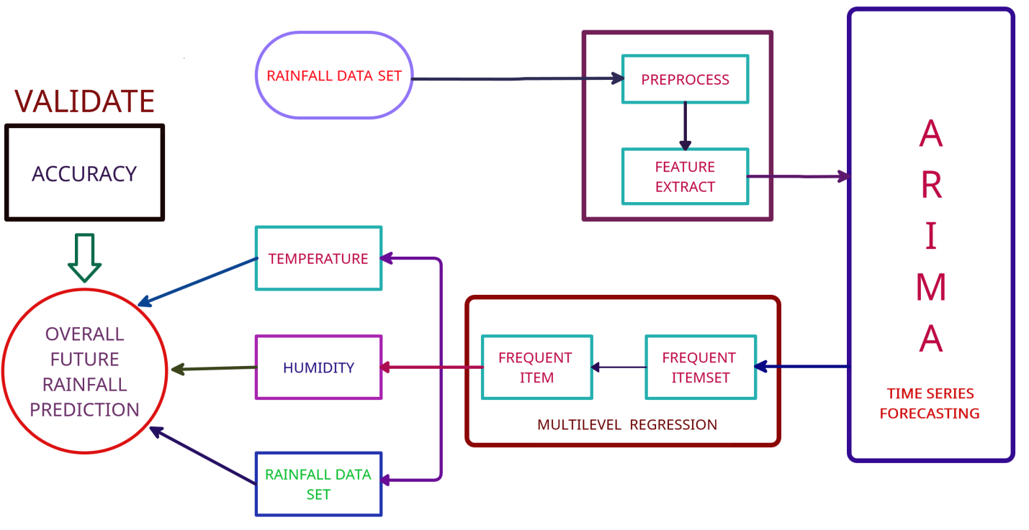
SYSTEM ARCHITECTURE

Slide 7
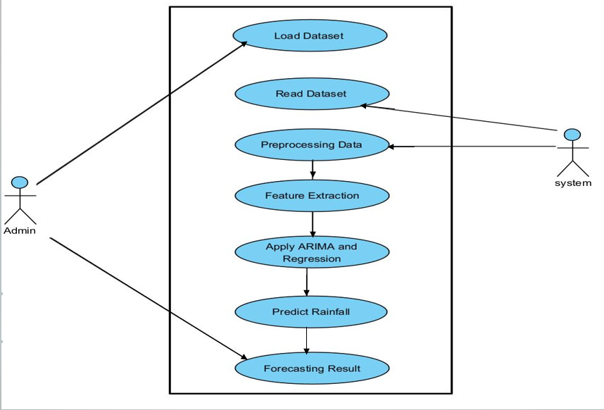
SYSTEM DESIGN - USECASE DIAGRAM

Slide 8
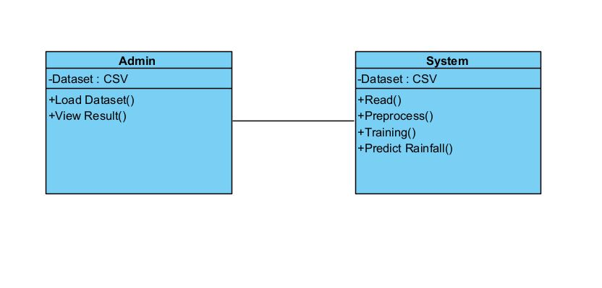
CLASS DIAGRAM

Slide 9
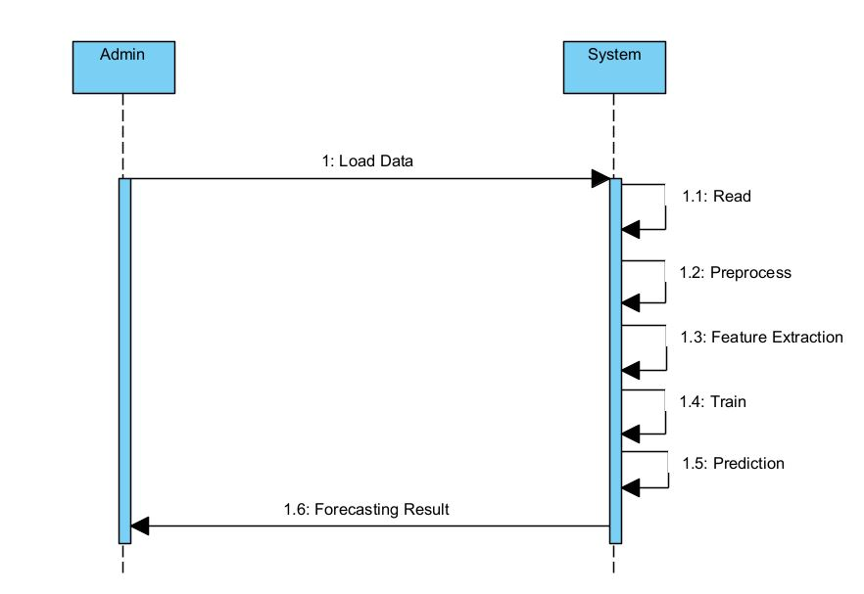
SEQUENCE DIAGRAM

Slide 10
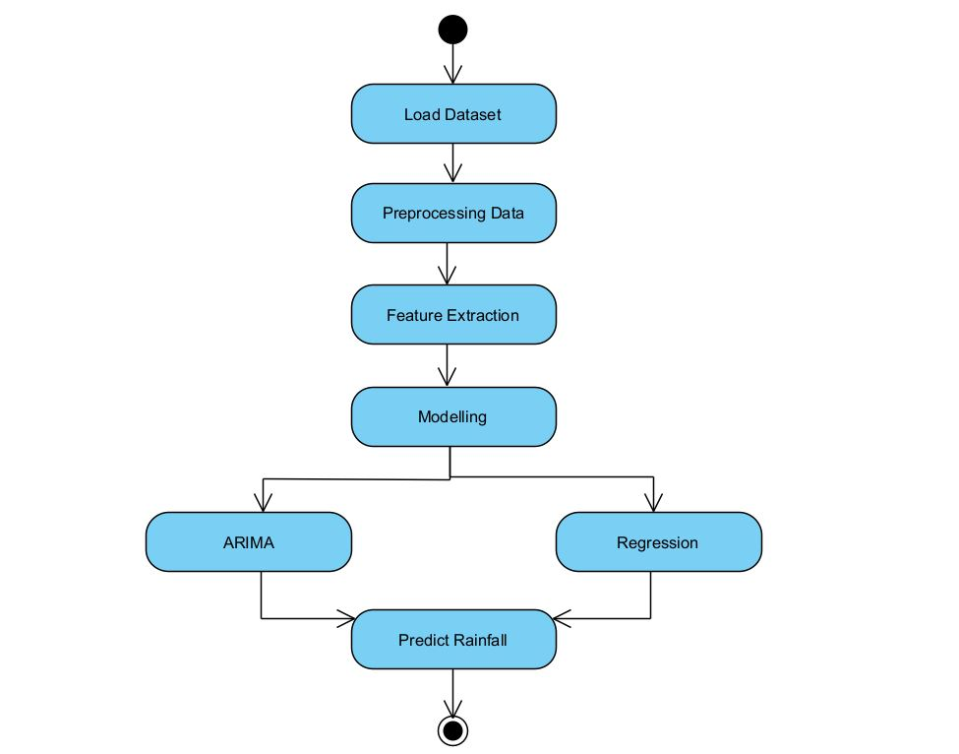
ACTIVITY DIAGRAM

Slide 11
MODULES
Data Collection.
Data Preprocessing.
Feature Extraction.
Linear Regression.
ARIMA (Auto Regressive Integrated Moving Average)
Ensemble Methods and Bagging.

Slide 12
DATA COLLECTION
Dataset is collected from Kaggle is used to collect random real-time data that is converted to a fixed format.
The algorithm efficiency and accuracy depend upon the correctness and quality of data collected.
There are 21 features available in the dataset like time, precip intensity, precip Intensitymax, precip probability, temperature min, temperature max, apparent temperature min, apparent temperature max, latitude, longitude, precip type, time., etc for the prediction of rainfall.
DATASETS
 | FILE FORMAT | DATA COUNT | SOURCE
Rainfall | CSV | 44728 | Kaggle

Slide 13
DATA PREPROCESSING
Data preprocessing is a technique that involves transforming raw data into an understandable format.
The dataset might contain empty values, negative values or errors.
Dataset is cleared in preprocessing stage.
The preprocessing method involves removing records which are not complete.
So, it creates reliable consistent data that improves the efficiency of the training data for analysis and also enables accurate decision making.
The bfill () method is used in our project to process input and complete empty values.
The bfill () method replaces NULL values ​​with the following line values. It is used to replenish non-database values. It will fill any NAN values ​​in the pandas data framework.

Slide 14
FEATURE EXTRACTION
Feature extraction is useful when we have a large dataset and need to reduce the number of resources without losing any important or relevant information.
The original dataset contains unwanted information which is not required for training the model.
So by using the feature extraction process only required information is extracted from the original dataset.
In our project we need only features like TempMax, TempMin, and PrecipIntensity for rainfall prediction.
State | Latitude | Longitude | TempMin | TempMax | Precip Intensity | Precip Probability
Karnataka | 15.31 | 75.71 | 18.62 | 30.26 | 0.0062 | 0.07
Haryana | 29.23 | 76.43 | 12.74 | 28.78 | 0.0034 | 0.02
Tamil Nadu | 11.05 | 78.38 | 22.92 | 32.32 | 0.0149 | 0.09
Kerala | 10.85 | 76.27 | 22.92 | 32.43 | 0.1591 | 0.41

Slide 15
LINEAR REGRESSION
Linear Regression is a method that describes the relationship between a dependent variable and a set of independent variables.
The equation of the line is given. It provides an estimate of rainfall using various atmospheric variables like cloud cover, humidity, wind, and average temperature to predict rainfall.
An estimate of rainfall is easy to determine at any given point since the regression method uses the previous correlation between the various atmospheric variables.

Slide 16
ARIMA
This model is used for time series prediction and analysis and forecasting. It contains four methods and is proposed by Box and Jenkins. The following are the four steps used in the ARIMA model.
Stage-1: Identification of a series of responses is done in the first stage which is used in calculating the time series and autocorrelations using statement IDENTIFY
Stage-2: In this stage Estimation of the previously identified variables is done and also the parameters are estimated using the statement ESTIMATE.
Stage-3: Diagnostics checking of the above-collected variables and parameters is done in this stage.
Stage-4: In this stage the predicting values of time series are forecasted which are future values, using the ARIMA model using the statement FORECAST.

Slide 17
ENSEMBLE METHOD AND BAGGING
Bagging is the ensemble learning method that is commonly used to reduce variance within a noisy dataset.
Ensemble learning is a machine learning paradigm where multiple models are trained to solve the same problem and combined to get better results.
Bagging generates multiple bootstrap data from the original dataset, constructs a prediction model in a uniform way for each bootstrap data, and combines the models to arrive at the final model.

Slide 18
PERFORMANCE EVALUATION
Linear Regression
Features | R-Squared | R-Squared %
TemperatureMin | 0.999 | 99.9
TemperatureMax | 0.996 | 99.6
PrecipIntensity | 0.643 | 64.3
ARIMA
 | MSE | RMSE | Error %
Observed | 27.68 | 5.26 | 19 %
Forecasted | 1058.85 | 32.54 | 3 %

Slide 19
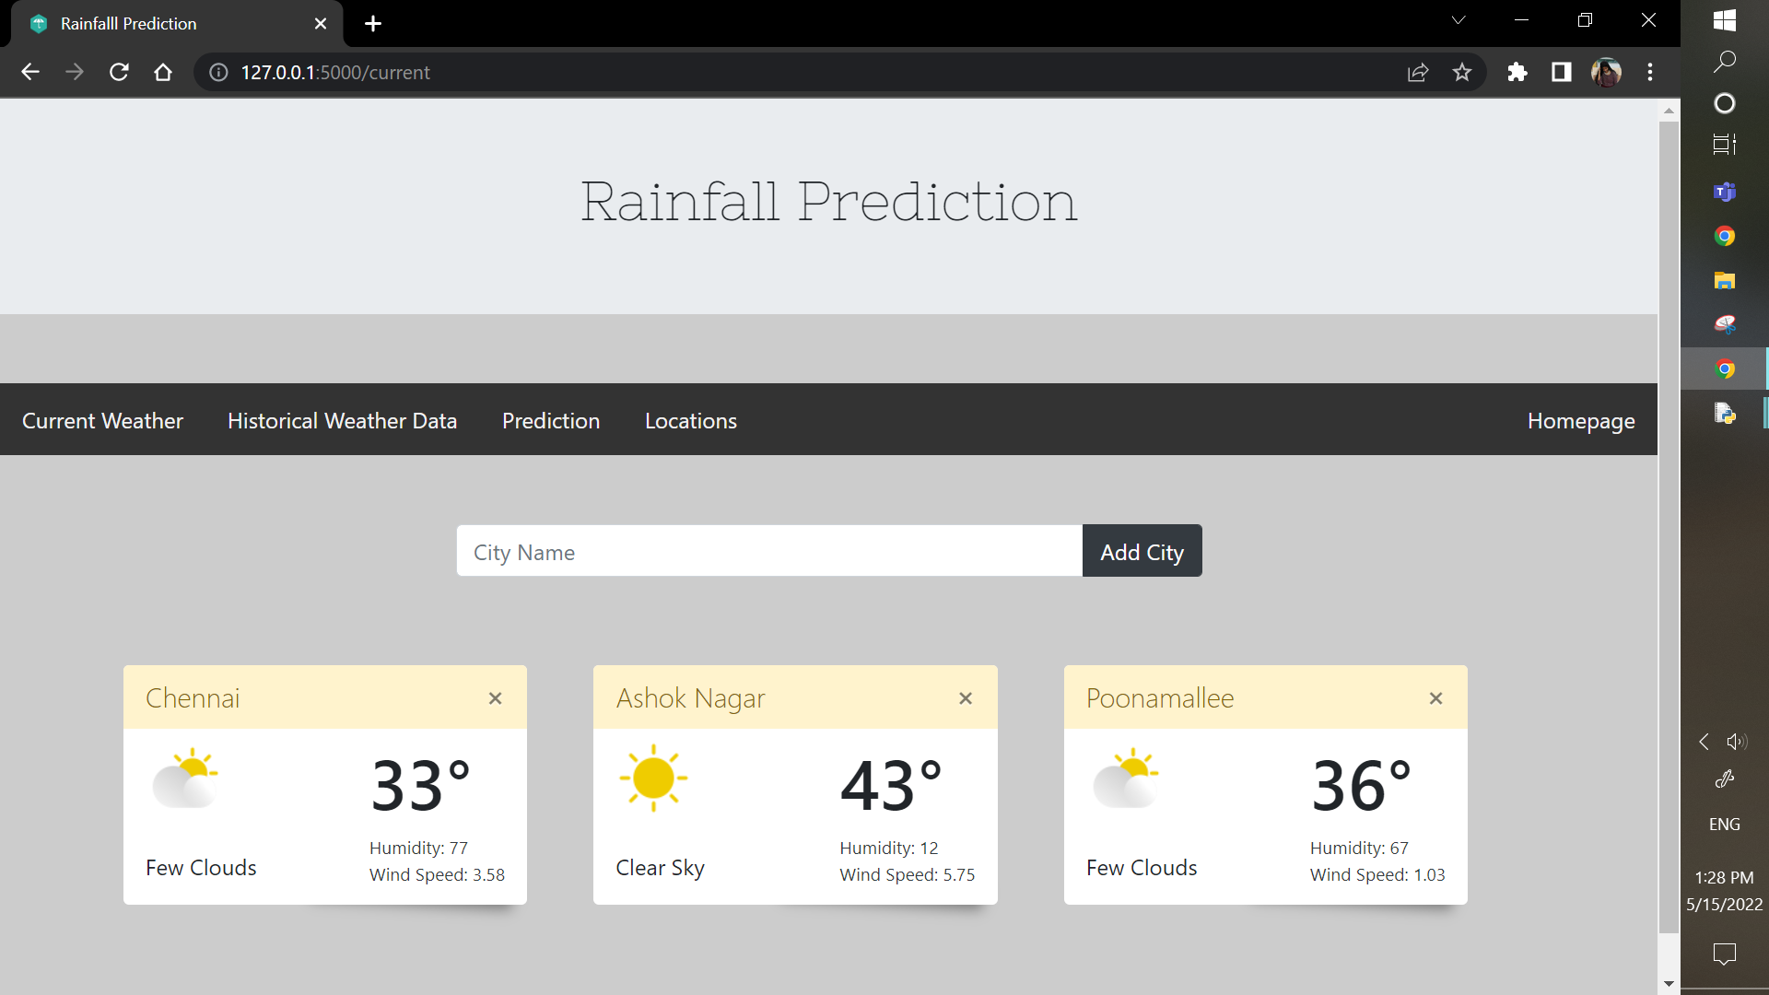
USER INTERFACE

Slide 20
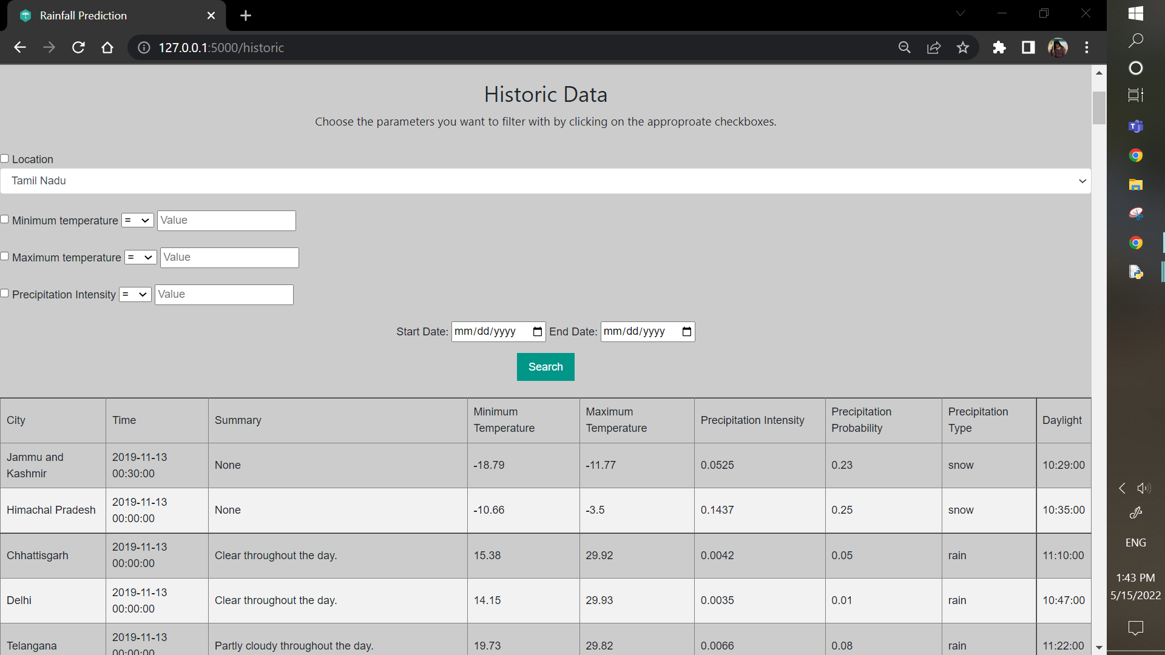
USER INTERFACE

Slide 21
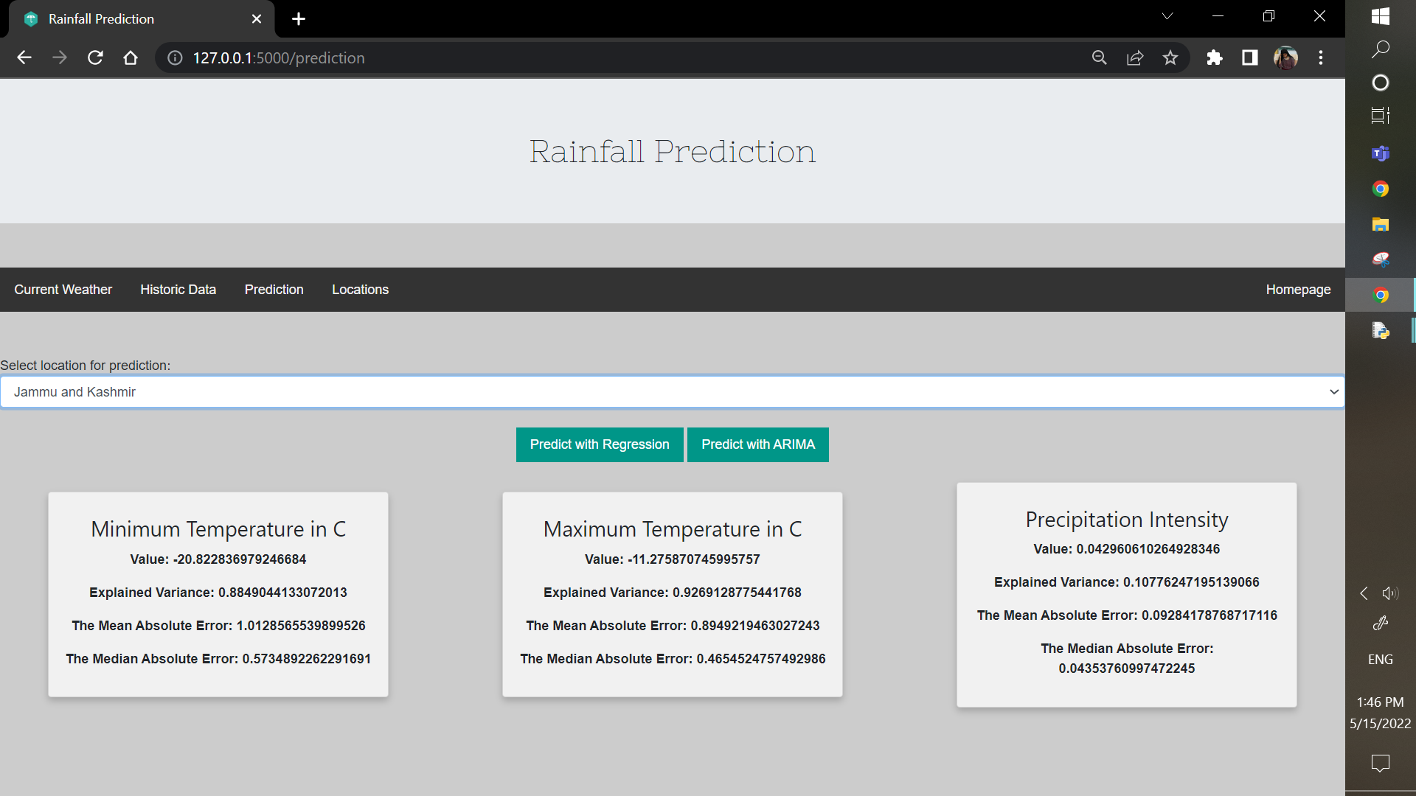
USER INTERFACE

Slide 22
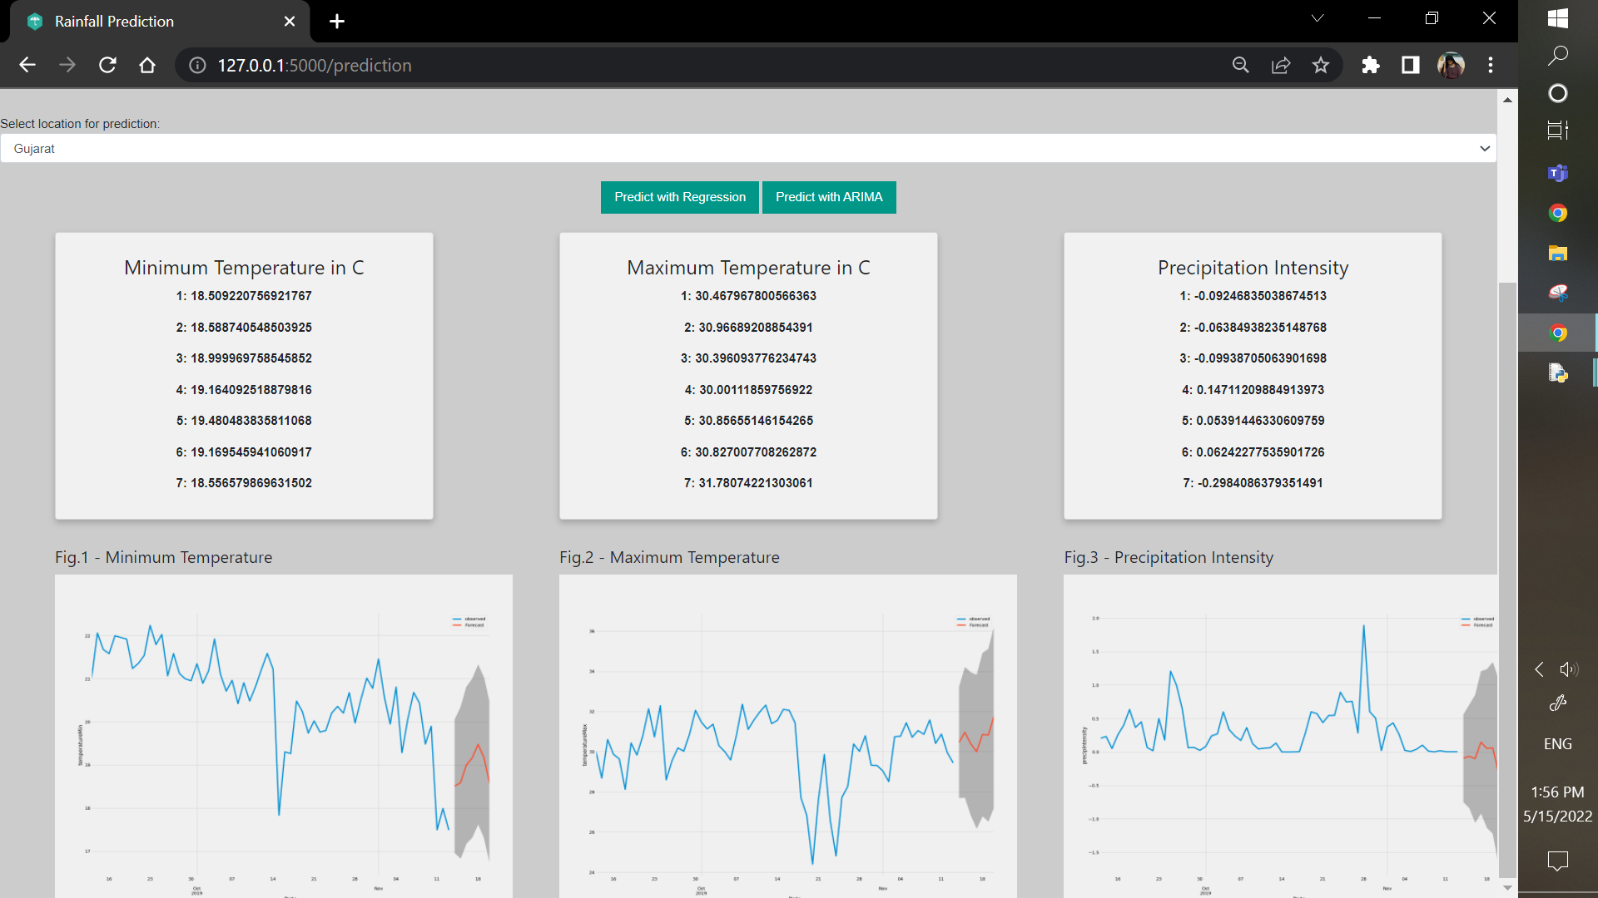
USER INTERFACE

Slide 23
CONCLUSION
The proposed study introduces a rainfall recommendations system that uses ARIMA and Linear Regression to provide computer-assisted results.
Depending on the data set used in a particular area, the model focuses on the variety of rainfall and its production in each area, as well as the weather and seasonal patterns.
The algorithms used for the recommendation function with ARIMA can be achieved when it rains during the rainy season or not is investigated and demonstrated.

Slide 24
REFERENCES
U.Ashwini, K.Kalaivani, K.Ulagapriya and A.Saritha (2021),“Time Series Analysis based Tamilnadu Monsoon Rainfall Prediction using Seasonal ARIMA”, IEEE.(https://ieeexplore.ieee.org/document/9358615)
Arnav Garg, Himanshu Pandey (2019), “Rainfall Prediction Using Machine Learning”, International Journal of Innovative Science and Research Technology, Volume 4, Issue 5,.(https://ijisrt.com/wp-content/uploads/2019/05/IJISRT19MY198.pdf)
Anosh Graham, Ekta Pathak Mishra (2017), “Time series analysis model to forecast rainfall for Allahabad region”, Journal of Pharmacognosy and Phytochemistry.(https://www.phytojournal.com/archives/2017/vol6issue5/PartU/6-5-80-125.pdf)
CMAK Zeelan Basha, Nagulla Bhavana, Ponduru Bhavya, Sowmya V (2020), “Rainfall Prediction Using Machine Learning & Deep Learning Techniques “, International Conference on Electronics and Sustainable Communication Systems.( https://ieeexplore.ieee.org/document/9155896)
Dechao Sun, Jiali Wu, Hong Huang, Renfang Wang , Feng Liang, and Hong Xinhua (2021), “Prediction of Short-Time Rainfall Based on Deep Learning”, Volume 2021, 8 pages. (https://www.hindawi.com/journals/mpe/2021/6664413/)
Moulana Mohammed, Roshitha Kolapalli, Niharika Golla, Siva Sai Maturi (2020), "Prediction Of Rainfall Using Machine Learning Techniques", international journal of scientific & technology research, volume 9, issue 01.(http://www.ijstr.org/final-print/jan2020/Prediction-Of-Rainfall-Using-Machine-Learning-Techniques.pdf)
Pengcheng Zhang, Yangyang Jia, Jerry Gao, Wei Song, Hareton Leung,(2018) “Short-term Rainfall Forecasting Using Multi-layer Perceptron”, IEEE. (https://ieeexplore.ieee.org/document/8468083)
Nana kofi ahoi appiah-badu, yaw marfo missah, leonard k. amekudzi, najim ussiph, twum frimpong, and emmanuel ahene,(2021), “Rainfall Prediction Using Machine Learning Algorithms for the Various Ecological Zones of Ghana”, IEEE, volume 10. ( https://ieeexplore.ieee.org/abstract/document/9664520)
Nitin Singh, Saurabh Chaturvedi, Shamim Akhter (2019),“Weather Forecasting Using Machine Learning Algorithm”, IEEE. (https://ieeexplore.ieee.org/document/8938211)
Uchamad Taufiq Anwar, Saptono Nugrohadi, Vita Tantriyati, Vikky Aprelia Windarni,(2020) “Rain Prediction Using Rule-Based Machine Learning Approach”, Advance Sustainable Science, Engineering and Technology.(http://journal.upgris.ac.id/index.php/asset/article/view/6019)
Wanie M. Ridwan, Michelle Sapitang, Awatif Aziz, Khairul Faizal Kushiar, Ali Najah Ahmed, Ahmed El-Shafie (2020),“Rainfall forecasting model using machine learning methods”, Ain Shams Engineering Journal.(https://www.sciencedirect.com/science/article/pii/S2090447920302069)

Slide 25
THANK YOU

